Slide 1



A Multi-indicator based Selection Strategy for Evolutionary Many-objective Optimization
2019 CEC, New Zealand, June 12, 2019
Hao Wang¹, Chaoli Sun¹, Yaochu Jin², Shufen Qin¹, Haibo Yu¹
¹ Department of Computer Science and Technology,
Taiyuan University of Science and Technology, Taiyuan, 030024, China
² Department of Computer Science,
University of Surrey, Guildford, GU2 &XH, UK
chaoli.sun.cn@gmail.com, chaoli.sun@tyust.edu.cn

Slide 2
Outlines
Motivation
A Multi-indicator based Selection Strategy for Evolutionary Many-objective Optimization
Experimental results and discussions
Conclusions

Slide 3
Motivation
The selection pressure will be lost when the number of objectives increase.
We need to focus both on the convergence and diversity of the population

Slide 4
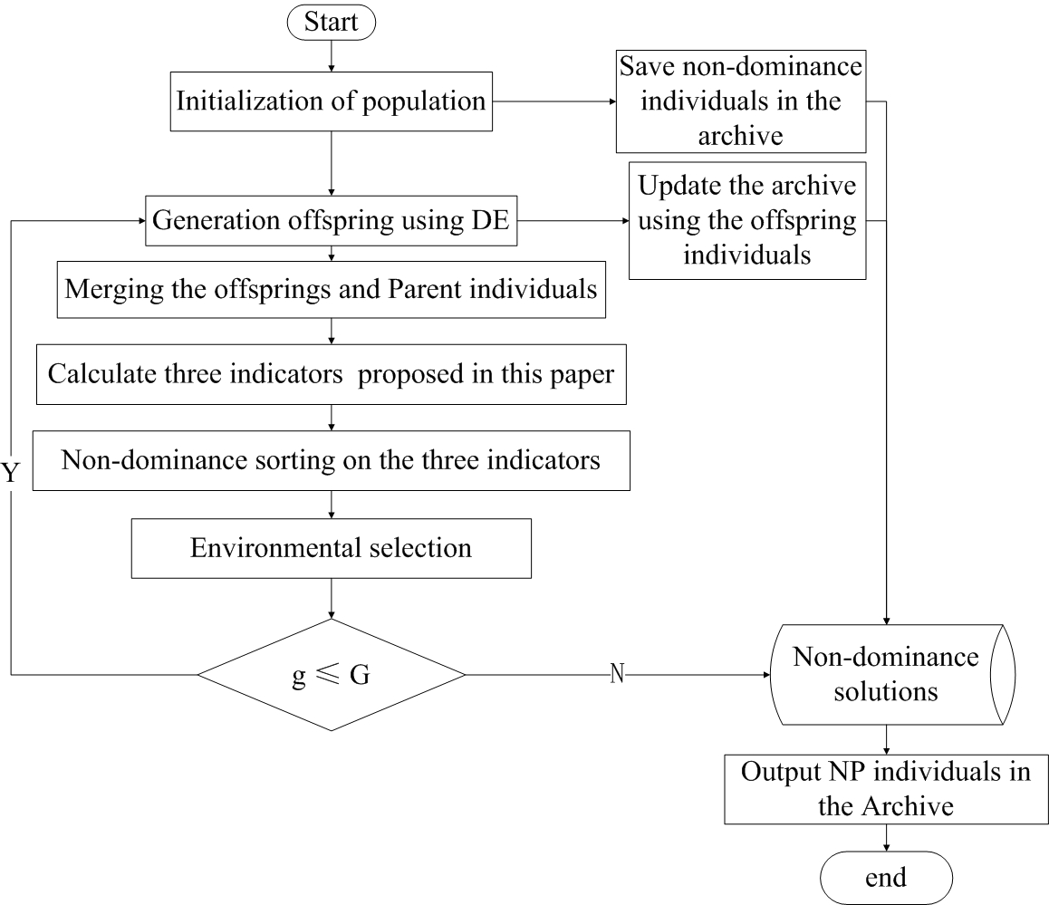
The flowchart of the proposed MISS-EA
Two convergence indicators
One diversity indicator

Slide 5
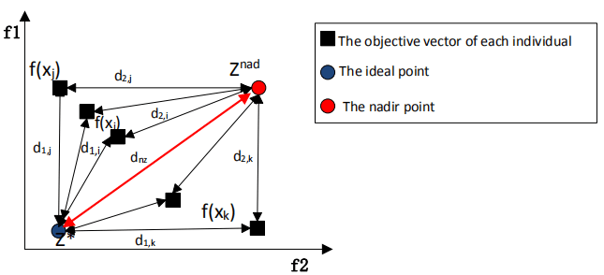


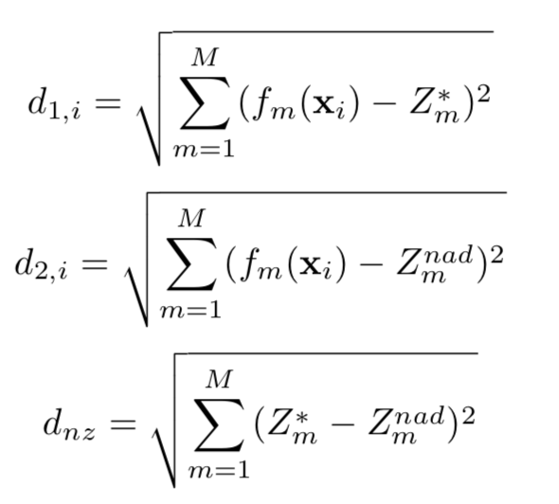
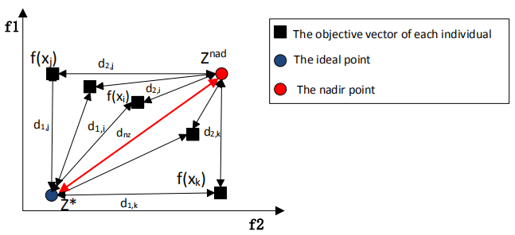
Convergence indicators

Slide 6
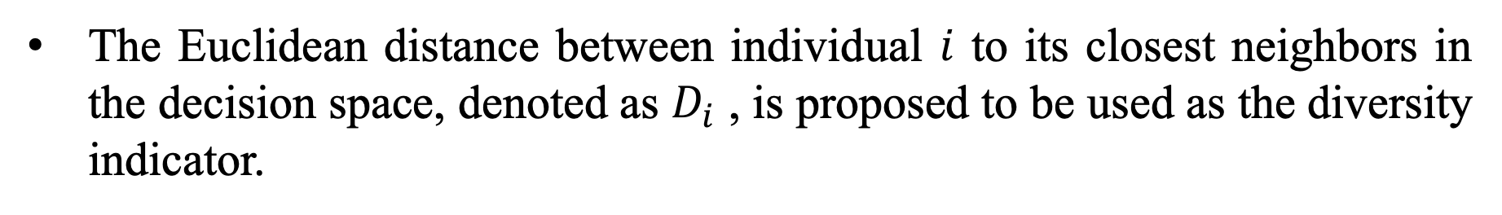
Diversity indicator
The Euclidean distance between individual $i$ to its closest neighbors in the decision space, denoted as $D_{i}$ , is proposed to be used as the diversity indicator.
The larger the distance to the individual's closest neighbor, the more likely it will be selected for the next generation.

Slide 7
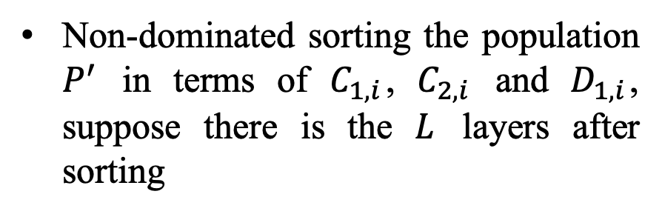
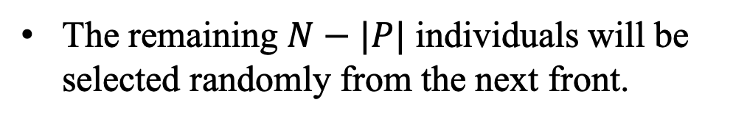
Environment selection
Non-dominated sorting the population $P^{′}$ in terms of $C_{1,i}$, $C_{2,i}$ and $D_{1,i}$, suppose there is the $L$ layers after sorting
The new parent population P is formed by adding solutions front by front in the combined population until the population size is exceeded.
The remaining $N−|P|$ individuals will be selected randomly from the next front.

Slide 8
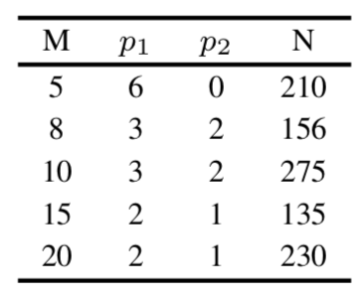
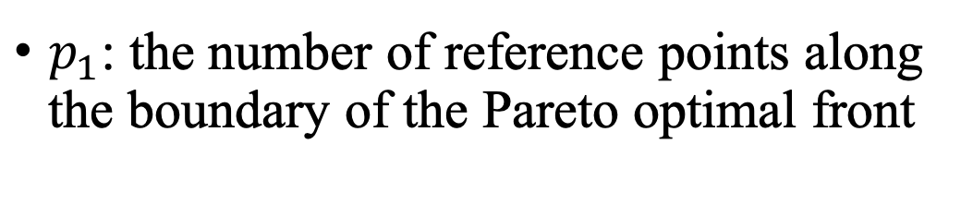
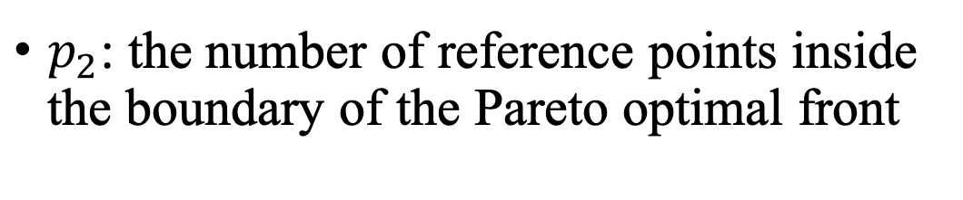
Parameter settings
M: number of objectives
$p_{1}$: the number of reference points along the boundary of the Pareto optimal front
$p_{2}$: the number of reference points inside the boundary of the Pareto optimal front
N: population size
20 independent runnings

Slide 9
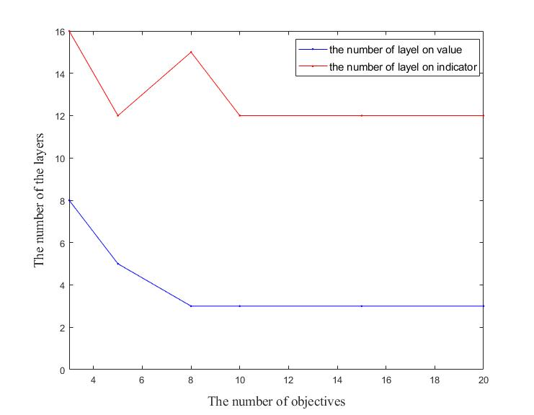
Experimental results and discussions

Slide 10
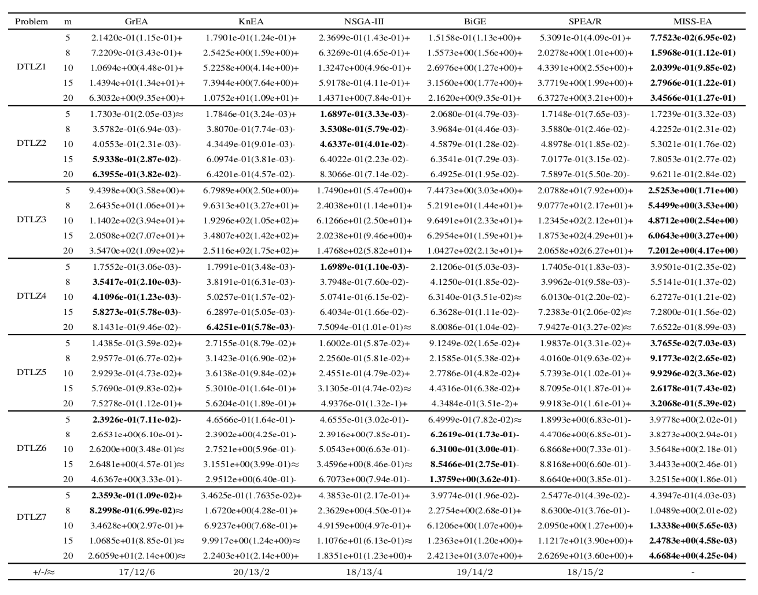

Slide 11
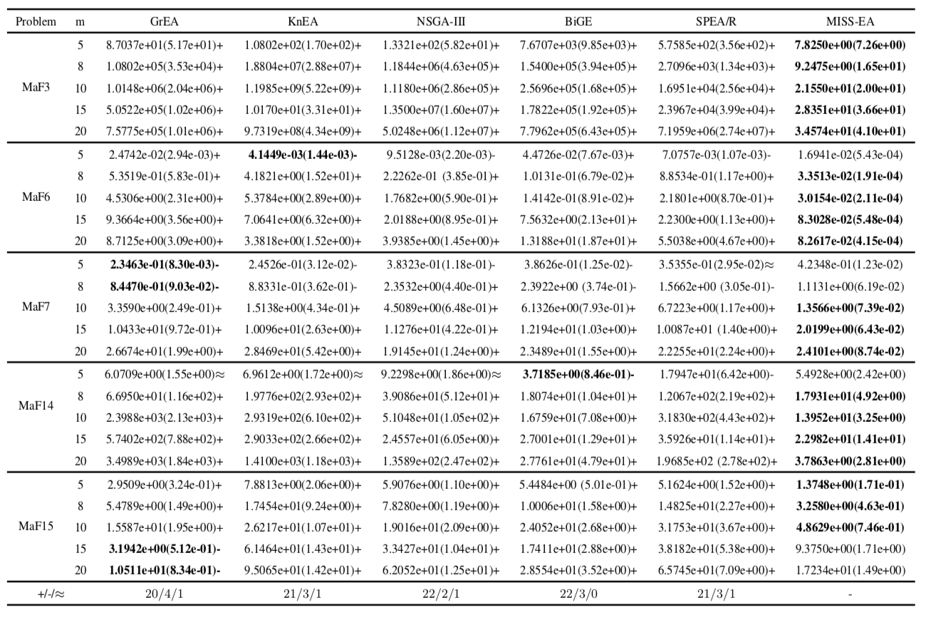

Slide 12
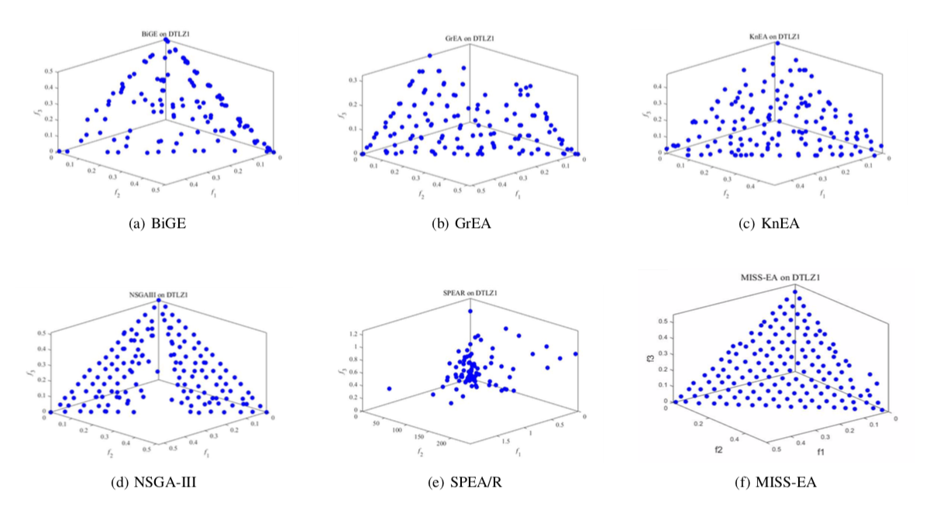
Pareto fronts achieved on DTLZ1

Slide 13
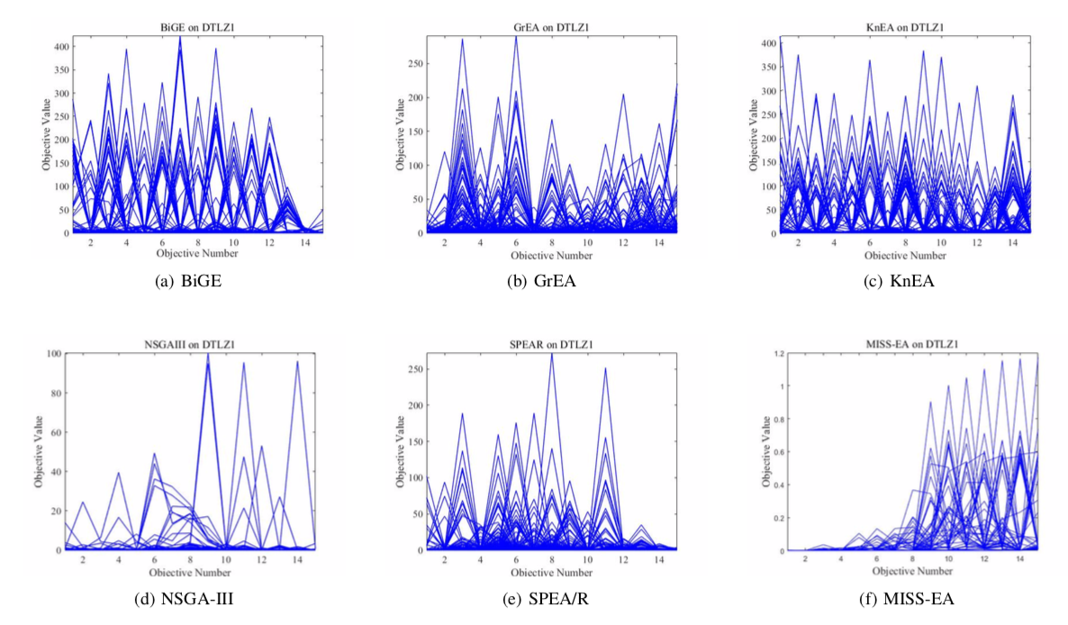
The parallel coordinates of non-dominated fronts on 15-objective DTLZ1

Slide 14
Conclusions
Three indicators were proposed in our paper
The non-domination sorting on three indicators was used for environment selection

Slide 15

Please contact me (chaoli.sun.cn@gmail.com) by email if you have any question or comments!

